Slide 1
Predictive MODELLING PROJECT US Real Estate Market: A Comprehensive Dataset
TEAM 11A

Slide 2
Content
INTRODUCTION
OBJECTIVE
PRE-PROCESSING
DATA DISTRIBUTION
MODELLING
CONCLUSION

Slide 3
introduction
In this project, we are Exploring the dynamics of real estate pricing in the US market by Leveraging data for insightful real estate analytics
Sourced from Zenrows.com via Google Dataset Search.
3

Slide 4
Business problem
Selection of the Problem
Objectives of the Study
Relevance to Current Market Dynamics
Gap in Existing Predictive Models
Understand Key Price Determinants
Enhance Accuracy of Price Predictions
Importance of Findings
Expected Outcomes
Value to Stakeholders
Contribution to Data-Driven Real Estate Practices
Informed Decision Making
Enhanced Market Understanding
4

Slide 5
Pre-processing
SAMPLE
Identify variables or factors influencing the process.
EXPLORE
Study interconnected relationships between data elements.
MODIFY
The data is parsed and cleaned, being then passed onto the modeling stage.
5

Slide 6
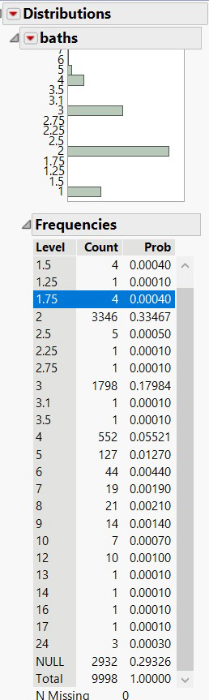
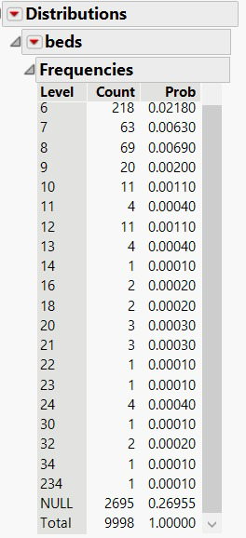
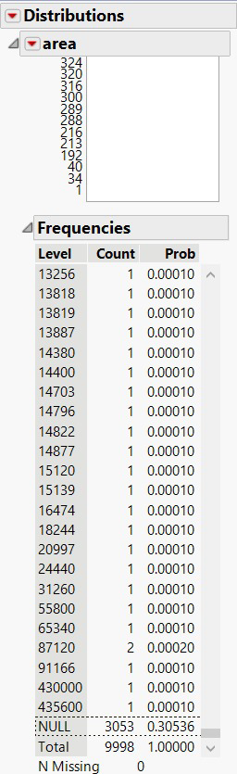
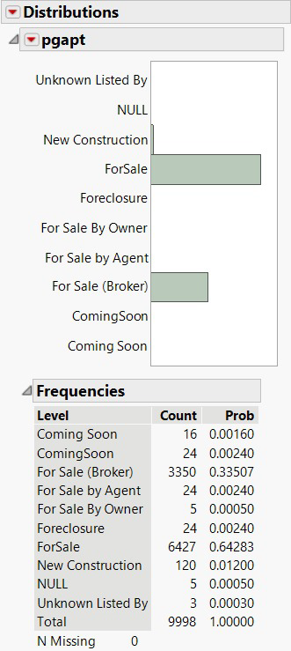
Pre-processing
NULL VALUES: We imputed above columns as they contained null numbers.
6

Slide 7
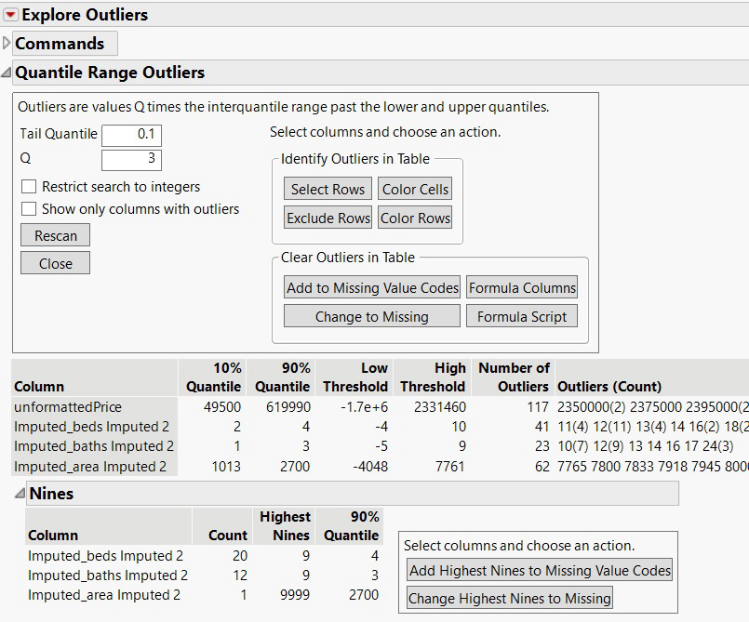
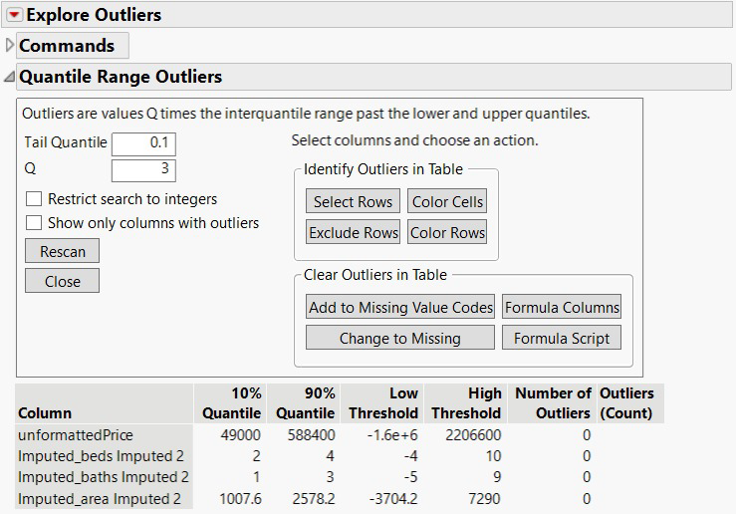
Pre-processing
OUTLIERS:
1. Explored Outliers as seen in left-side photo. 2. Post analysis removed outliers which is visible in right-side photo.
7

Slide 8
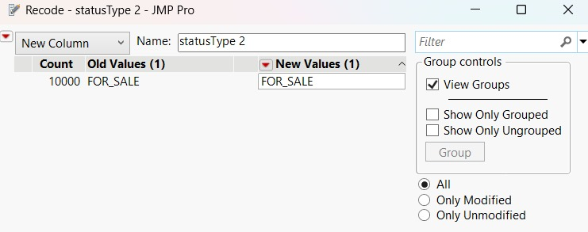
Pre-processing
We excluded below mentioned columns as they were not dependent or related to the Target Variable i.e Unformattedprice zpid, id, providerlistingid, imgsrc, hasImage, detailURL, countrycurrency, address, addressStreet, addressZipcode, isUndisclosedAddress, latitude, longitude, variableDataText, VaribaleDataType, brokername, relaxed, sgapt, has3DModel, hasVideo, isHomeRec, info2String, info3String, brokerName, hasOpenHouse, openHouseStartDate, openHouseEndDate, openHouseDescription, info6String, Column 47 , StatusText
We excluded this columns as it has just a single value i.e FOR_SALE StatusType
8

Slide 9
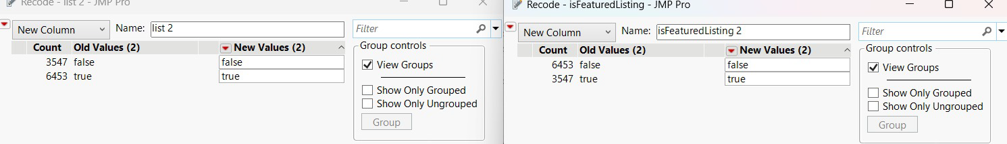
Pre-processing
Since both columns have identical data & exactly opposite data, we decided to keep only one of the 2 columns i.e. isFeaturedListing
9

Slide 10
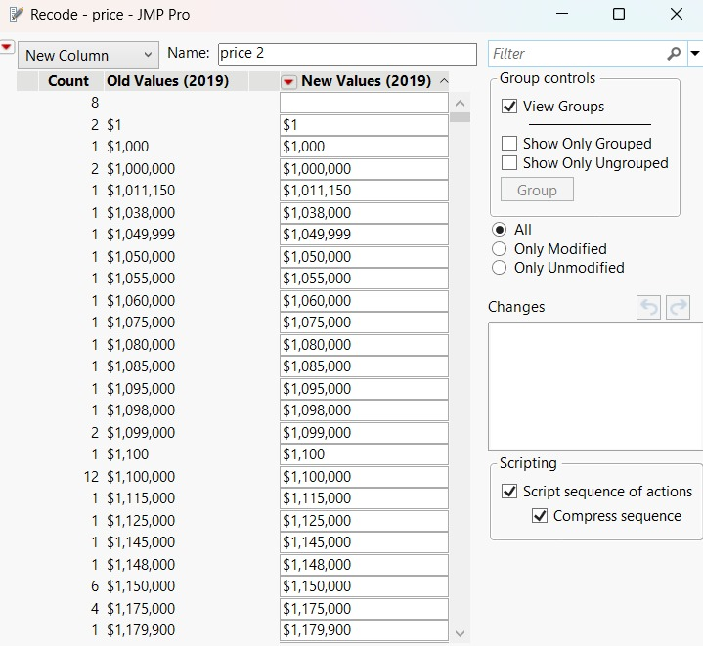
Pre-processing
We excluded this column because we already have column called unformattedprice having all numeric values.
10

Slide 11
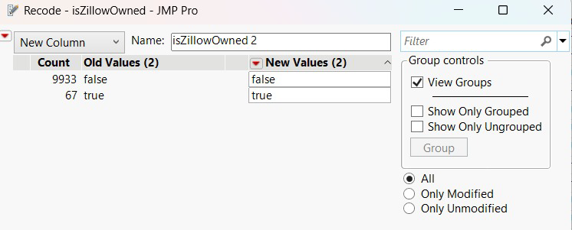
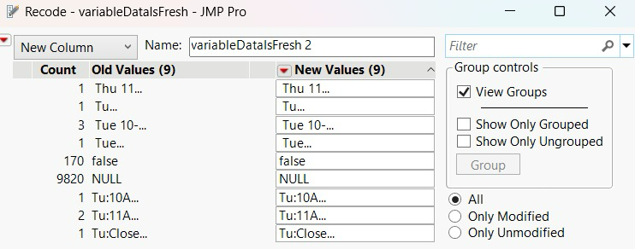
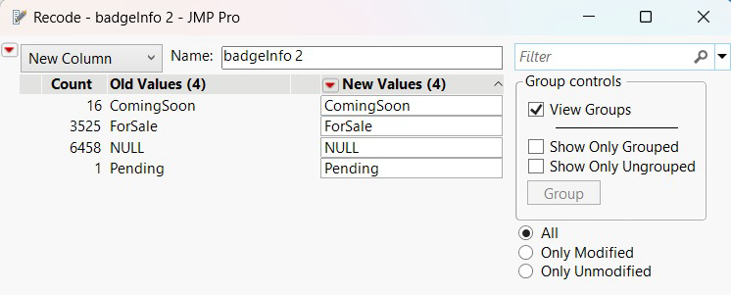
Pre-processing
99% of the data in this column belong to same category thus excluded.
98% of the data is null and rest are dates which are not relevant to the target variable.
Over 60% of data is NULL and above 35% data belong to single category.
11

Slide 12
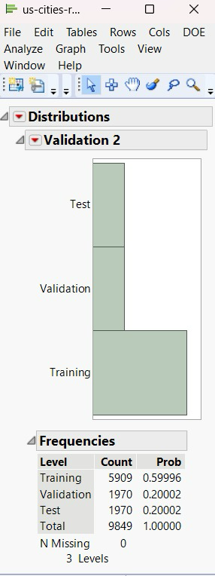
DATA DISTRIBUTION
Data Split for Model Development
Data distribution across Training, Validation, and Test sets.
Training set comprises approximately 60% of the total data.
Validation and Test sets each contain 20% of the data.
Equal distribution in Validation and Test sets ensures unbiased model evaluation.
No missing values indicating a complete split.
12

Slide 13
MODELS

Slide 14
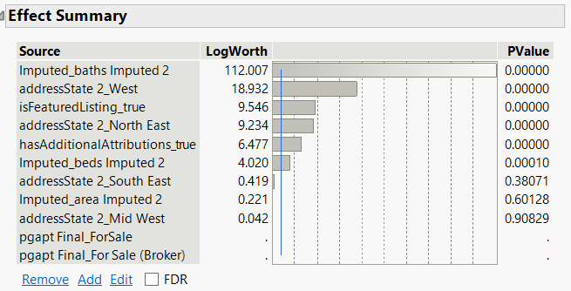
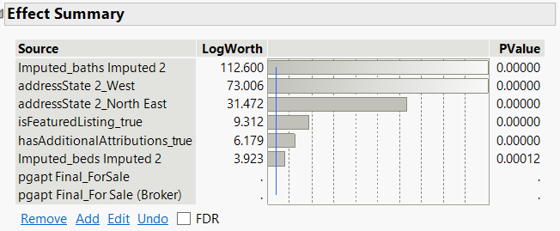
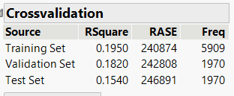
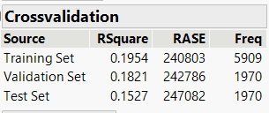
1.Linear regression – Standard least square
Determining the Impact of Predictors on Property Prices
Imputed_baths and Imputed_beds show the highest statistical significance.
Geographical location, specifically West and Northeast, are strong price determinants.
Listing features such as 'isFeaturedListing' and 'hasAdditionalAttributions' play a notable role.
Variables show varying levels of LogWorth, indicating their influence strength.
P-Values close to zero suggest strong evidence against the null hypothesis for the associated predictors.
14

Slide 15
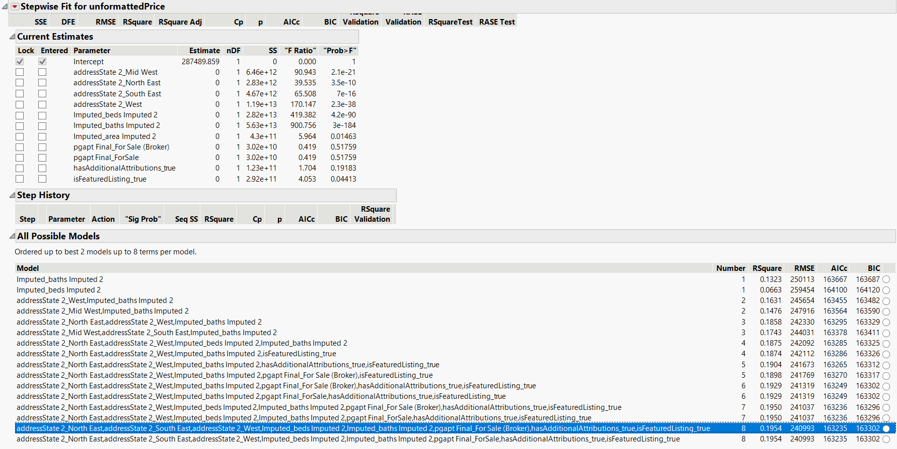
2. NEURAL NETWORK: Significant Variable contribution for Neural
We chose this row because the Rsquare value is the highest and RMSE values is least when compared to the other values.
15

Slide 16
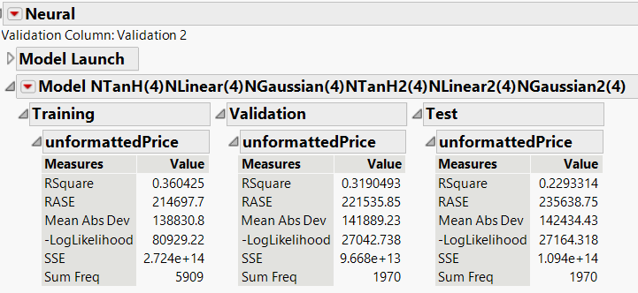
2. NEURAL NETWORK:
Neural Network Performance on unformattedPrice:
Application of Neural Network model to predict unformattedPrice.
Model architecture includes TanH and Linear activation functions.
Training Set Metrics:
R-Square of 0.3604 indicates moderate fit to the data.
RASE and Mean Absolute Deviation reflect the model’s prediction error.
Validation Set Results:
Slight decrease in R-Square to 0.3190 in validation set.
Consistent prediction error metrics with the training set.
Test Set Metrics
Further reduction in R-Square to 0.2293 in test set.
Increased prediction error indicating model’s performance on unseen data.
16

Slide 17
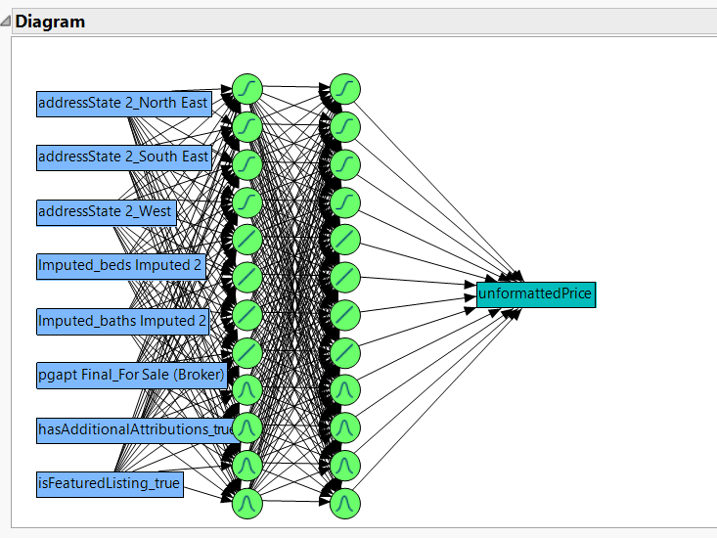

2. NEURAL NETWORK:
Visualization of data flowing through the neural network
17

Slide 18
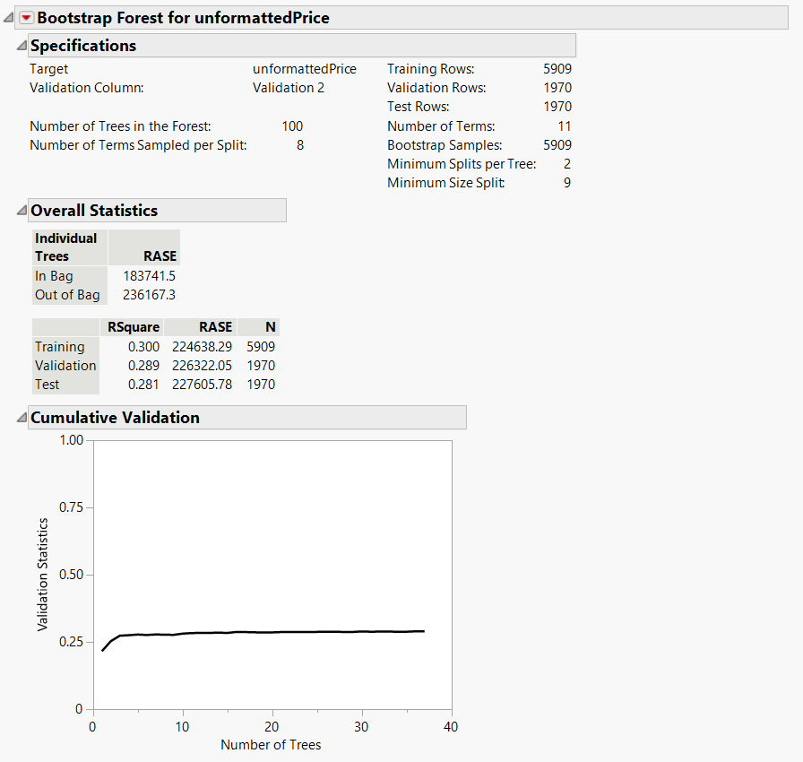
3. BOOTSTRAP FOREST
Bootstrap Forest Model Overview:
Predicting unformattedPrice with 100 trees in the forest.
Model uses 8 terms sampled per split, with a minimum of 2 splits per tree.
Each tree is built on a bootstrap sample of the same size as the original training dataset.
Model Performance Metrics
R-Square of 0.300 in training shows the model's decent explanatory power.
RASE indicates the model's prediction error across In-Bag and Out-of-Bag samples.
Consistent RASE values across Training, Validation, and Test sets suggest stable model performance.
Cumulative Validation Graph
Cumulative validation curve flattens as the number of trees increases, indicating stabilization.
Demonstrates diminishing returns in model improvement after a certain number of trees.
18

Slide 19
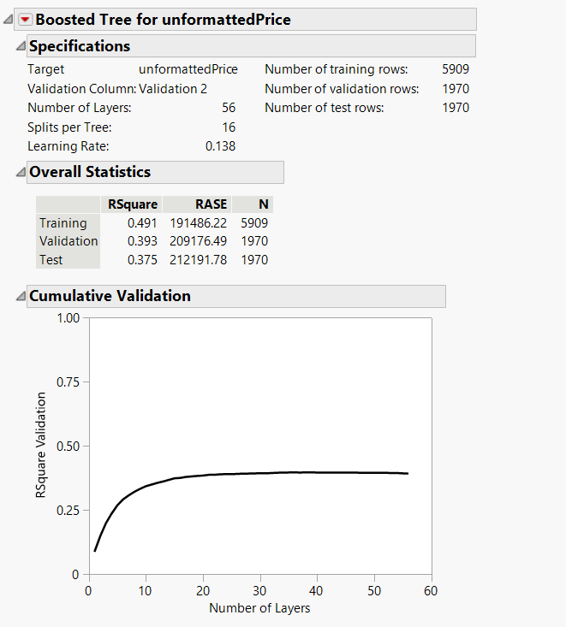
4. BOOSTED TREE
Specifications of the Boosted Tree Model:
Target variable: unformattedPrice.
Model consists of 56 layers with 16 splits per tree.
Applied to 5909 training, 1970 validation, and 1970 test rows.
Model Performance Metrics
Training set R-Square: 0.491 indicates model captures nearly half of variance.
Validation R-Square: 0.393, Test R-Square: 0.375 show performance on unseen data.
RASE provides insight into model's prediction error.
Analysis of Layer Impact on Model Validation
Graph depicts R-Square validation stabilizing with an increasing number of layers.
Indicates model performance reaching optimal levels beyond a certain complexity.
19

Slide 20
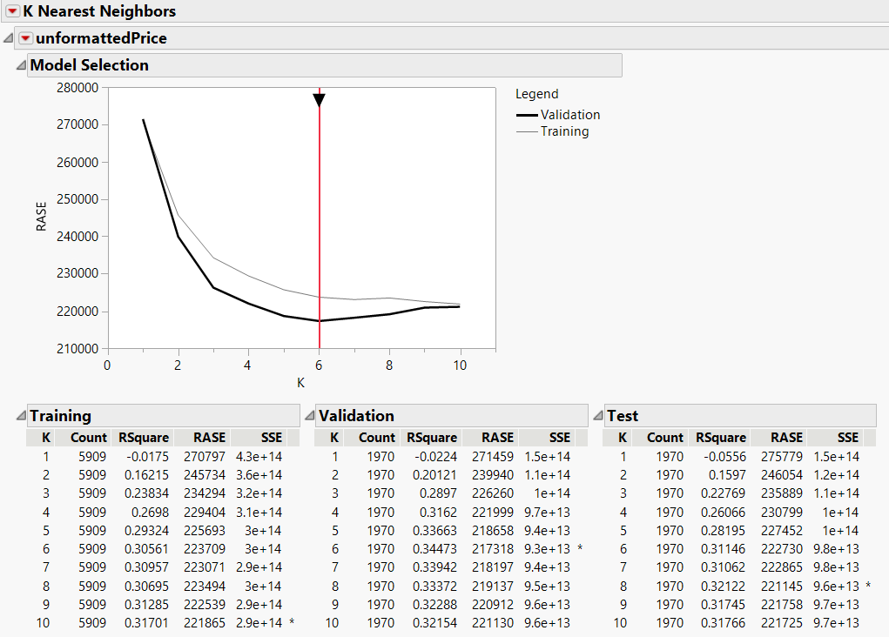
5. KNN(K Nearest Neighbors)
Graph Interpretation:
RMSE trends for Training vs. Validation"
Optimal K value indicated for model generalizability"
Model Fit Improvement:
R-Square improvement with increasing K
RMSE and SSE reduction signifies better fit
Model Selection:
K=5 as the optimal model complexity
Validation and test sets confirm model consistency
Practical Implication:
Model's predictive power maximized at K=5
Balancing complexity and performance for real-world application
20

Slide 21
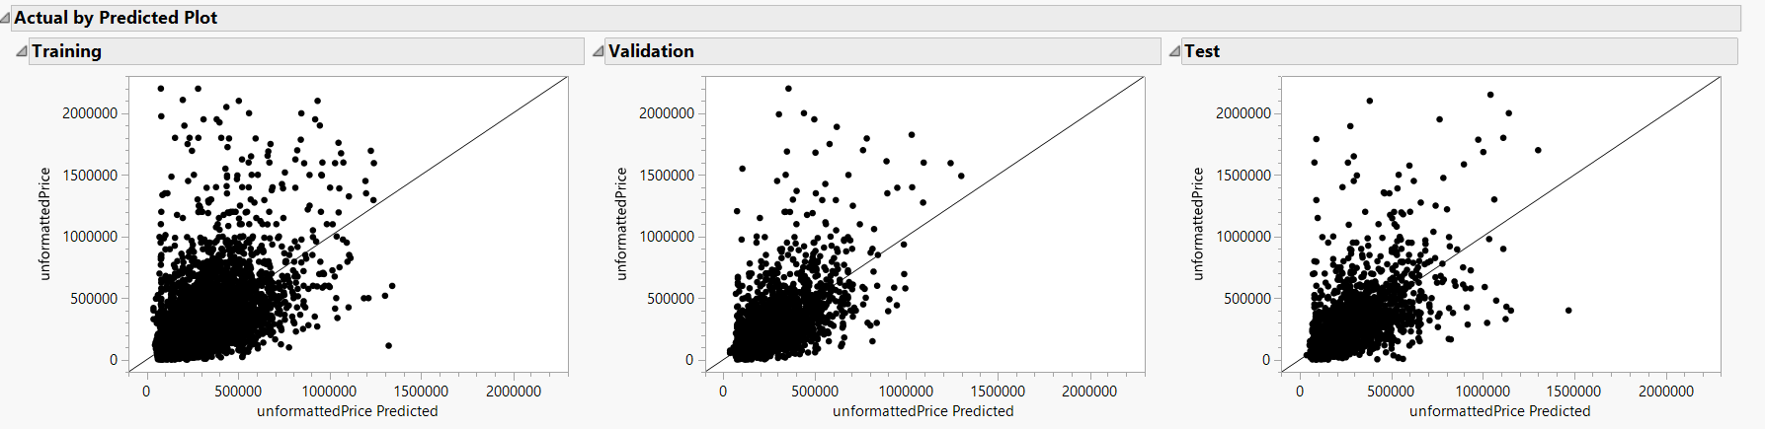
5. KNN(K Nearest Neighbors)
21

Slide 22
ASSESS

Slide 23
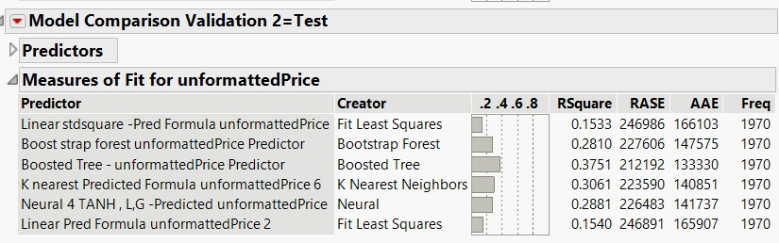
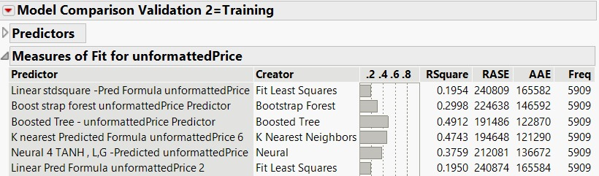
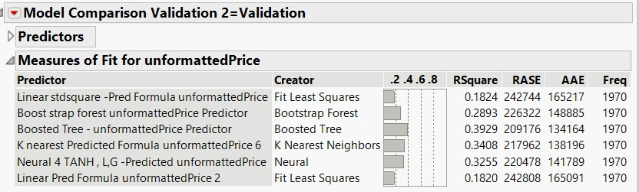
Comparison OF MODELS
Training Set Model Comparison:
Comparison of various predictive models
"Boosted Tree and Bootstrap Forest outperform Linear and Neural models
"Bootstrap Forest shows lower error rates (RASE) and high R² values
Validation Set Model Performance:
Bootstrap Forest maintains lower RASE on the validation set
Consistent performance with high R² values
Indicates robustness and reliability of the Bootstrap Forest model
Test Set Model Evaluation:
Bootstrap Forest demonstrates strong generalizability on unseen data
Balanced measure of fit (RASE and R²) compared to other models
Affirms Bootstrap Forest as the model of choice for accurate predictions
23

Slide 24
CONCLUSION
Model Performance Summary
Optimal Model Justification
Stakeholder Benefits
Evaluated multiple predictive models
Boosted Tree and Bootstrap Forest outperformed linear regression
Higher R-square values indicate better fit for complex pricing dynamics
Lower error metrics (RMSE, AAE) suggest greater prediction accuracy
Boosted Tree model yielded the best overall performance
Balance of accuracy and complexity considered
Model efficiency and predictive power prioritized
Accurate pricing strategies for sellers and agents
Informed investment decisions for buyers and investors
Data-driven market insights for enhanced competitiveness
24

Slide 25
CONCLUSION
Insights and Learning
Actionable Recommendations
Contributions to Real Estate Analytics
Non-linear relationships critical in price determination
Ensemble methods capture market complexity effectively
Data preprocessing and feature selection pivotal for model success
Adopt ensemble modeling techniques for valuation
Utilize predictive models for market trend analysis
Incorporate model insights into marketing and sales strategies
Advanced analytics driving real estate industry transformation
Project exemplifies the integration of data science in market valuation
Foundation laid for ongoing innovation and strategic decision-making
25

Slide 26
THANK YOU
26

